Slide 1
Application Presentation
April 12, 2024
Isamu Sherman, Anurag Reddy, Kaen Zhang

Slide 2
Presentation Overview
Introduction to Application
The Vision behind
Core Features and Functionalities
Technical Architecture and Design
User Interface Preview
6. Room Database
7. How it Works
8. Challenges we are Solving
9. Future Development Plans
10. What did we learn

Slide 3


Slide 4
Introduction to Application

Slide 5
The Vision behind

Slide 6
Core Features and Functionalities

Slide 7
Technical Architecture and Design

Slide 8
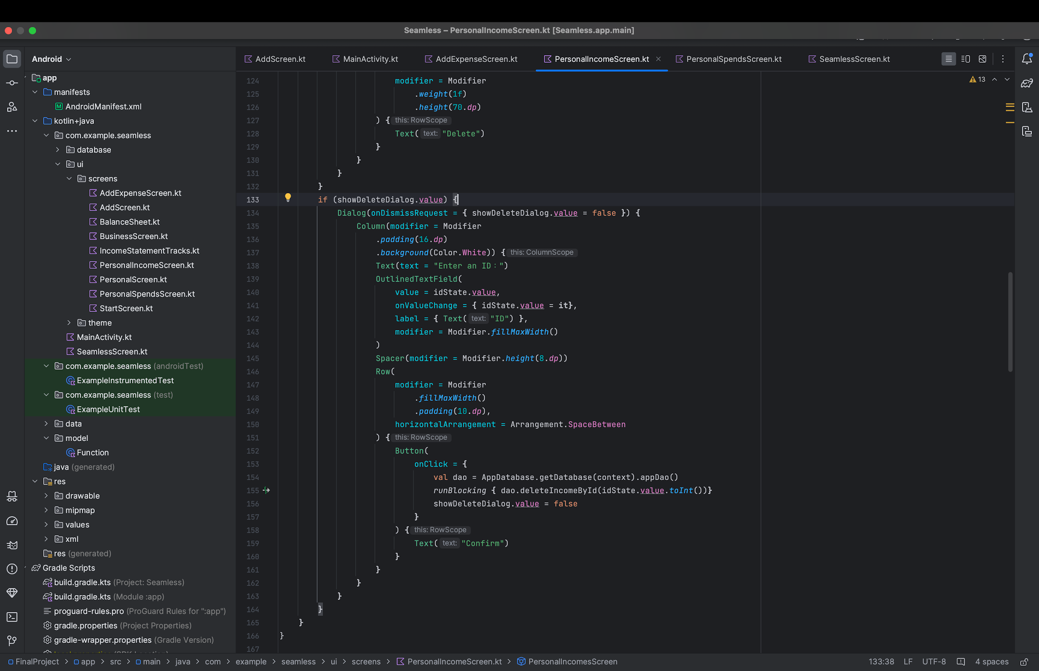
User Interface Preview

Slide 9
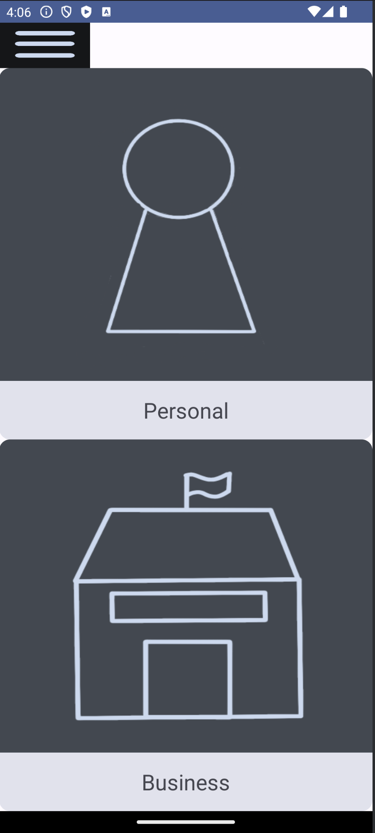
Setting button
Personal User
Income
Expenses
Business User
Income
Expenses
Investor (future)

Slide 10
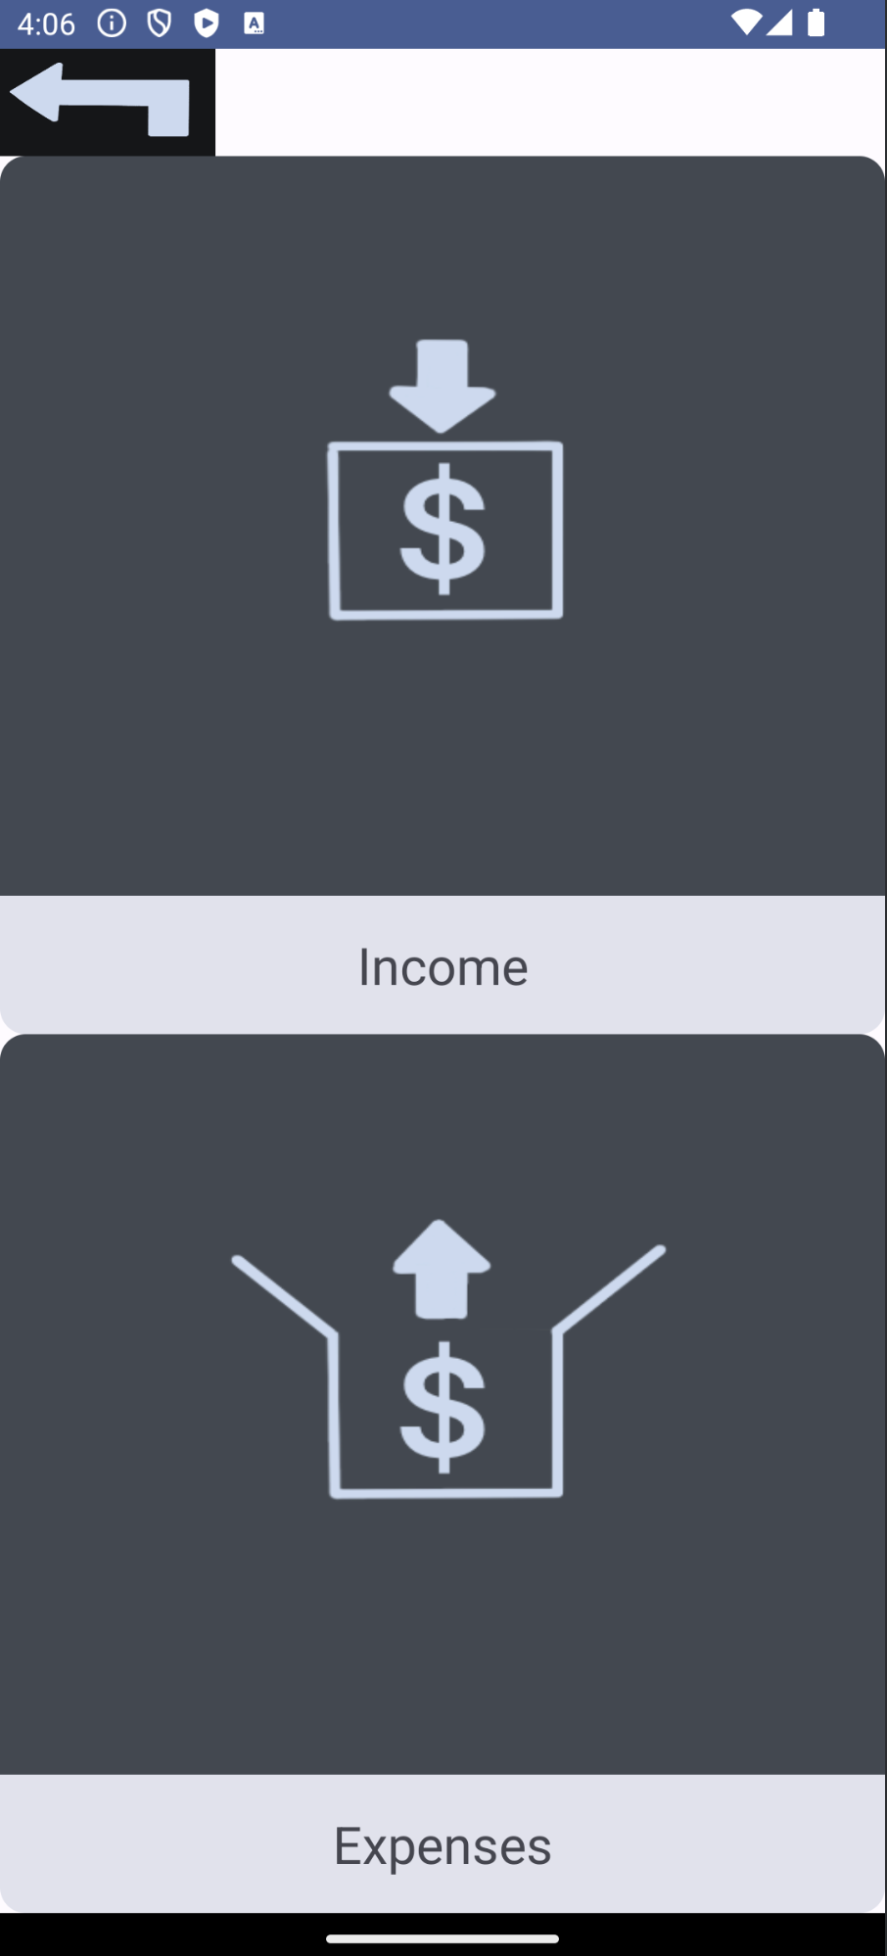
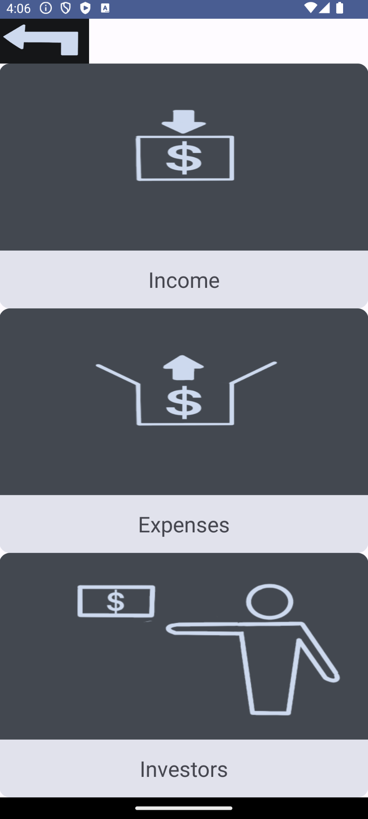
Return Button
Income
Add
Delete
Name
Categories
Desctiption
Amount
Expenses

Slide 11
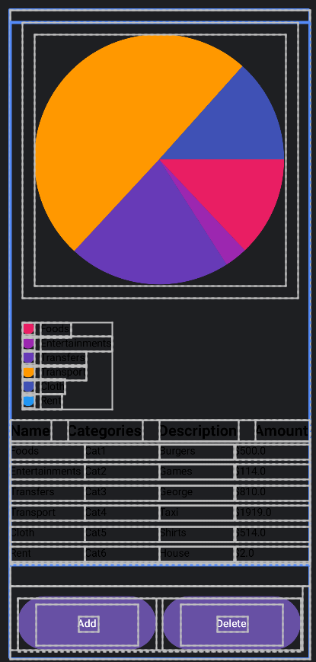
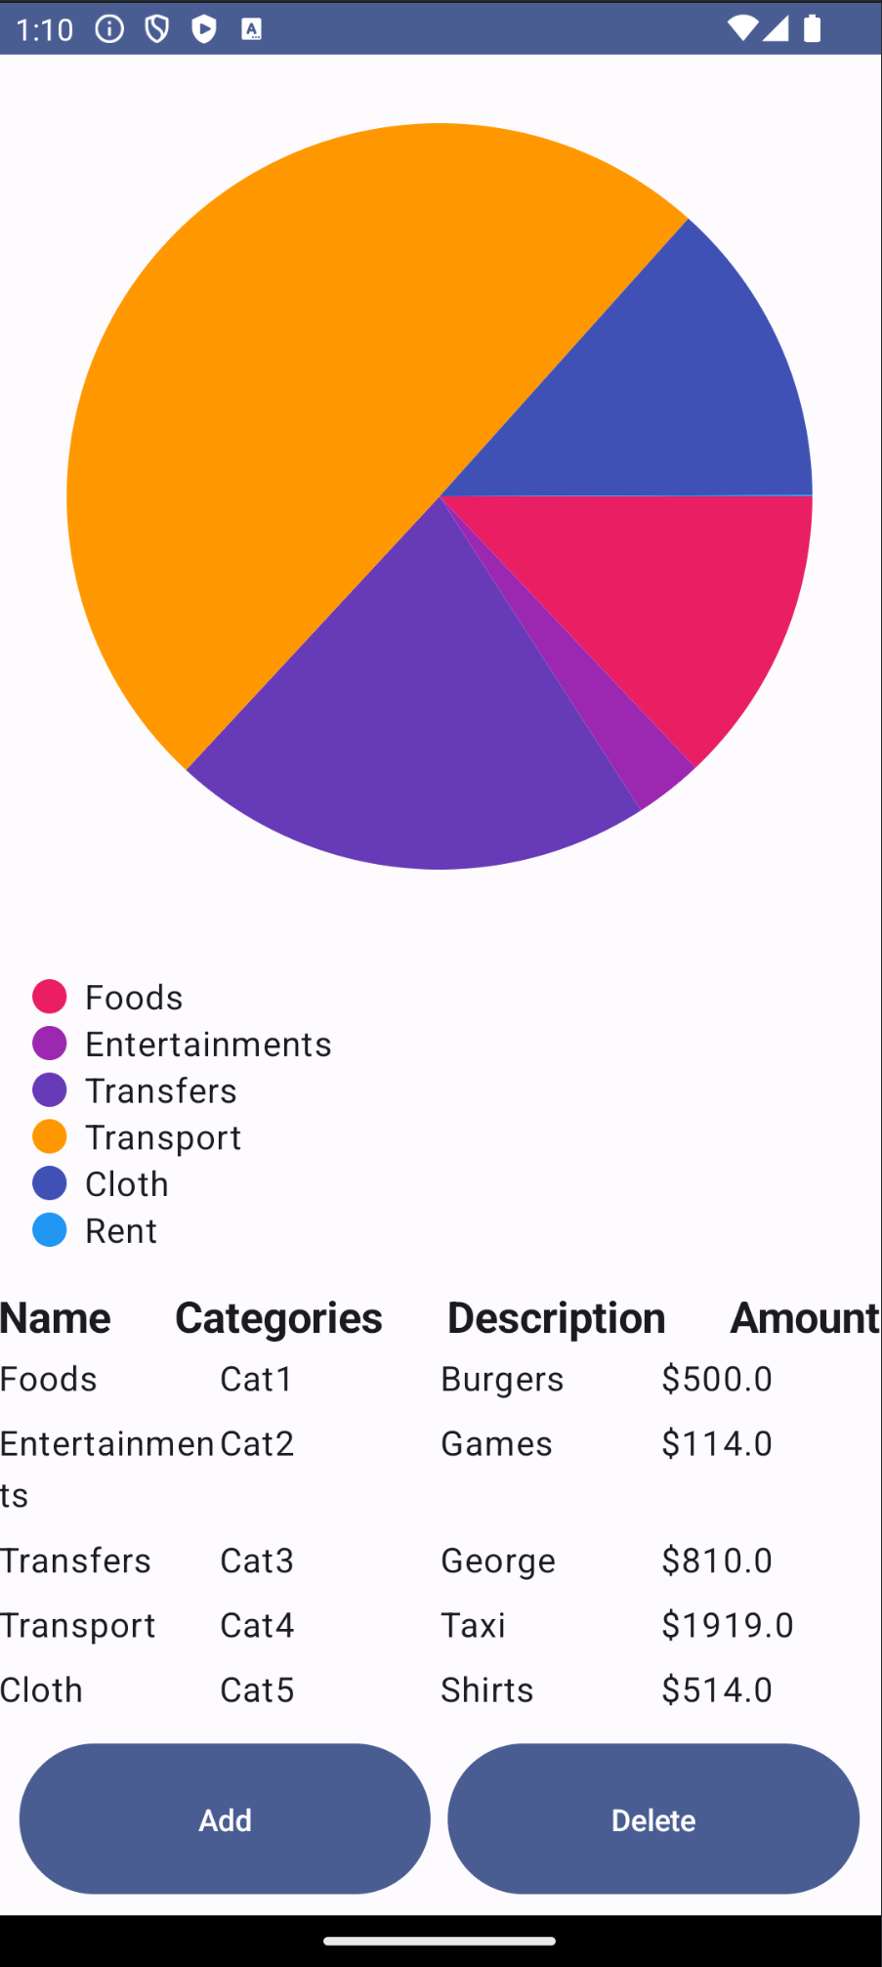
ChartPart
Chart Legends
Browse Part
Add / Delete Buttons

Slide 12
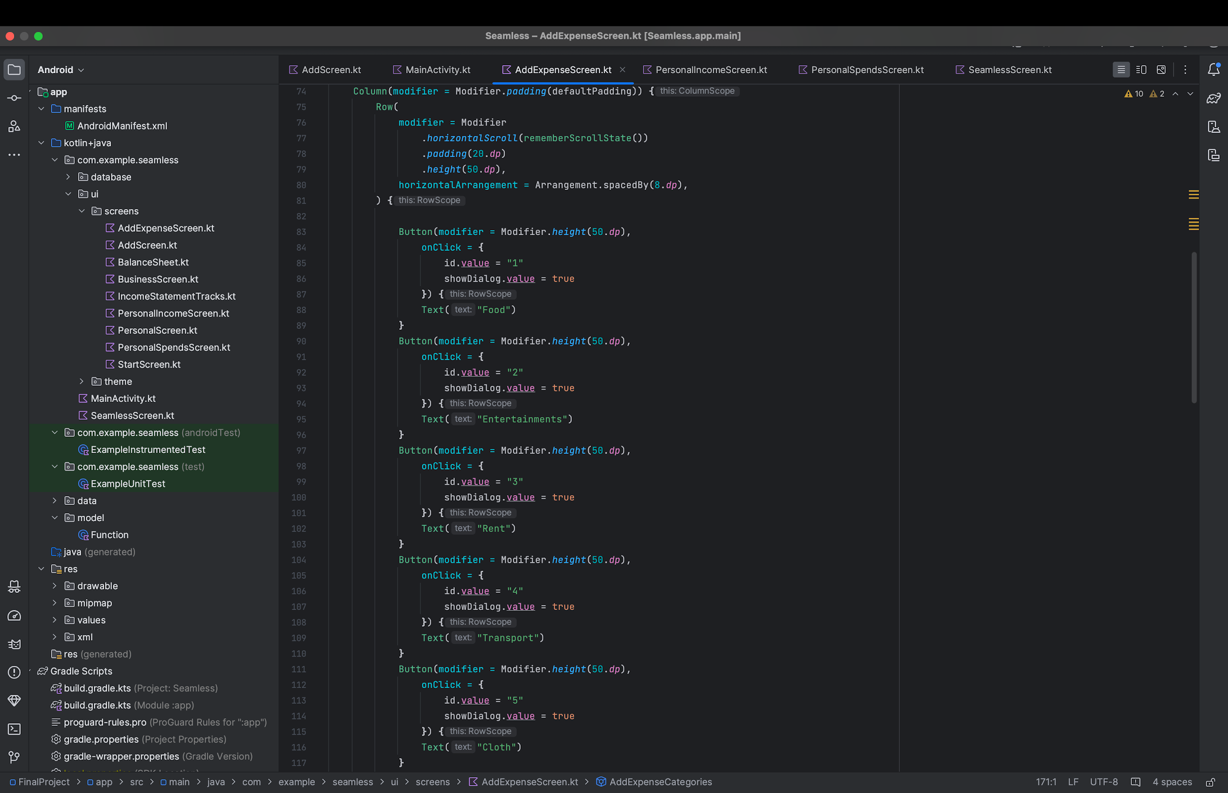
How it Works

Slide 13
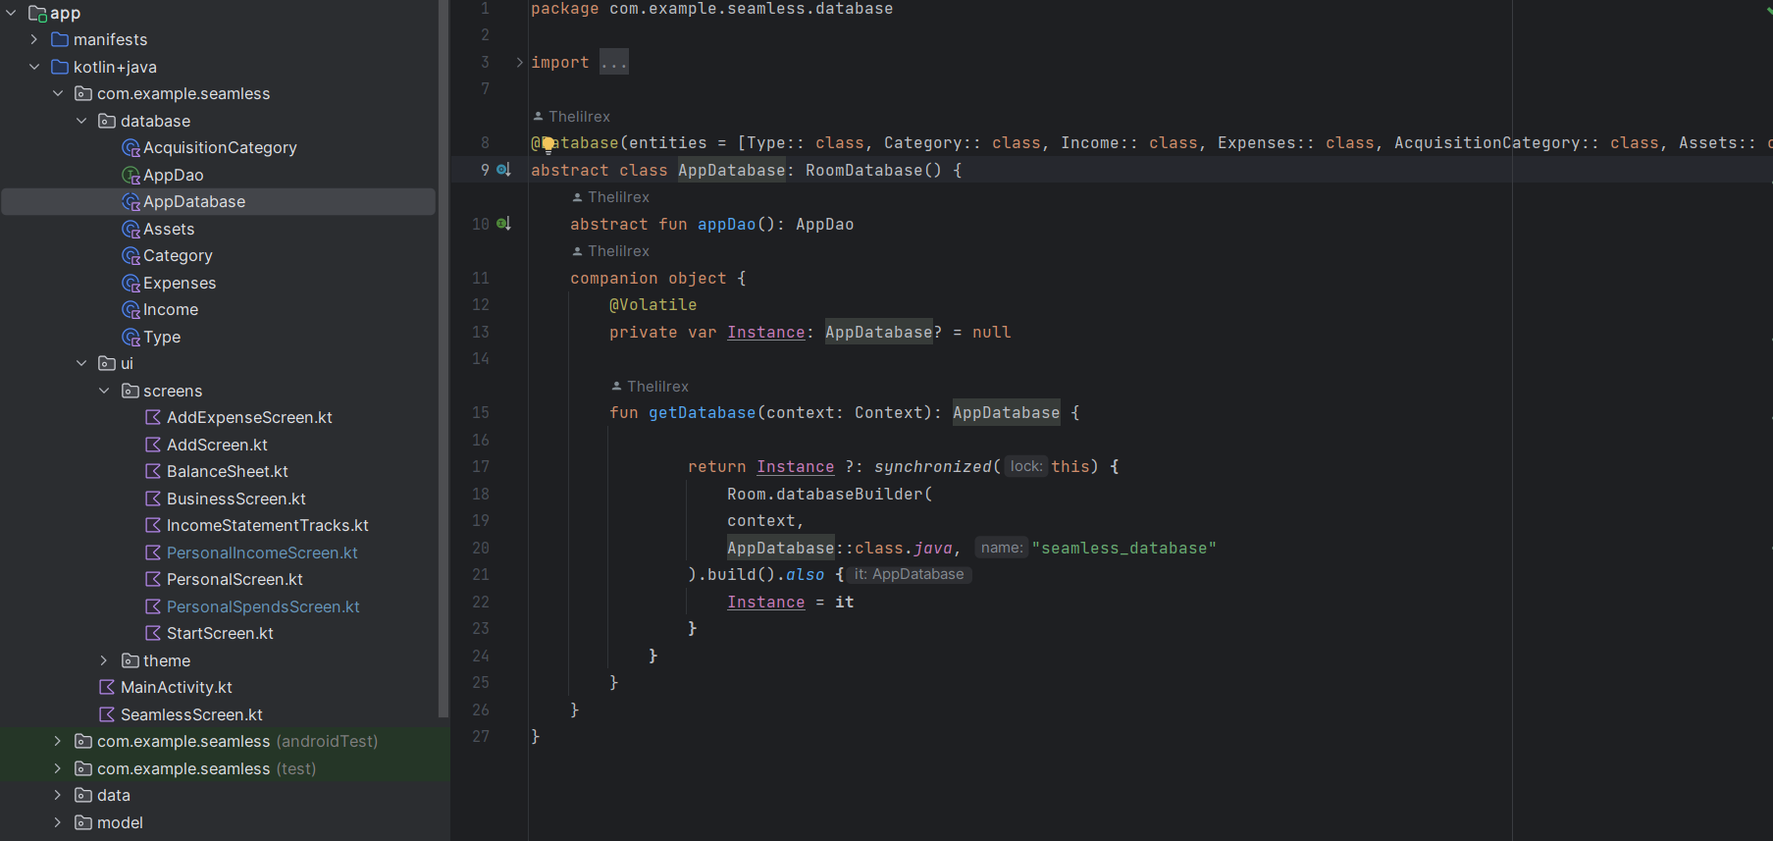
Room Database

Slide 14
Challenges we are Solving

Slide 15
Future Development Plans

Slide 16
What did we learn

Slide 17
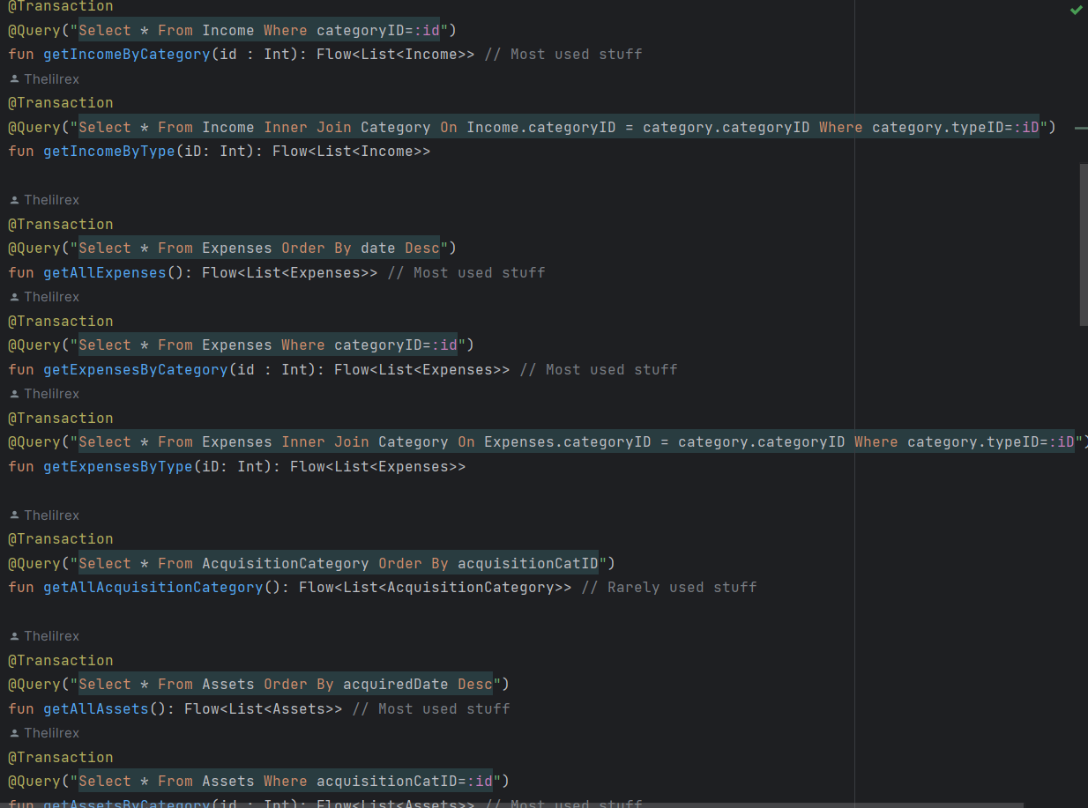
Room
Room is a layer over MySql.
Used for local storage.
Needs DAO
Some predefined functions

Slide 18
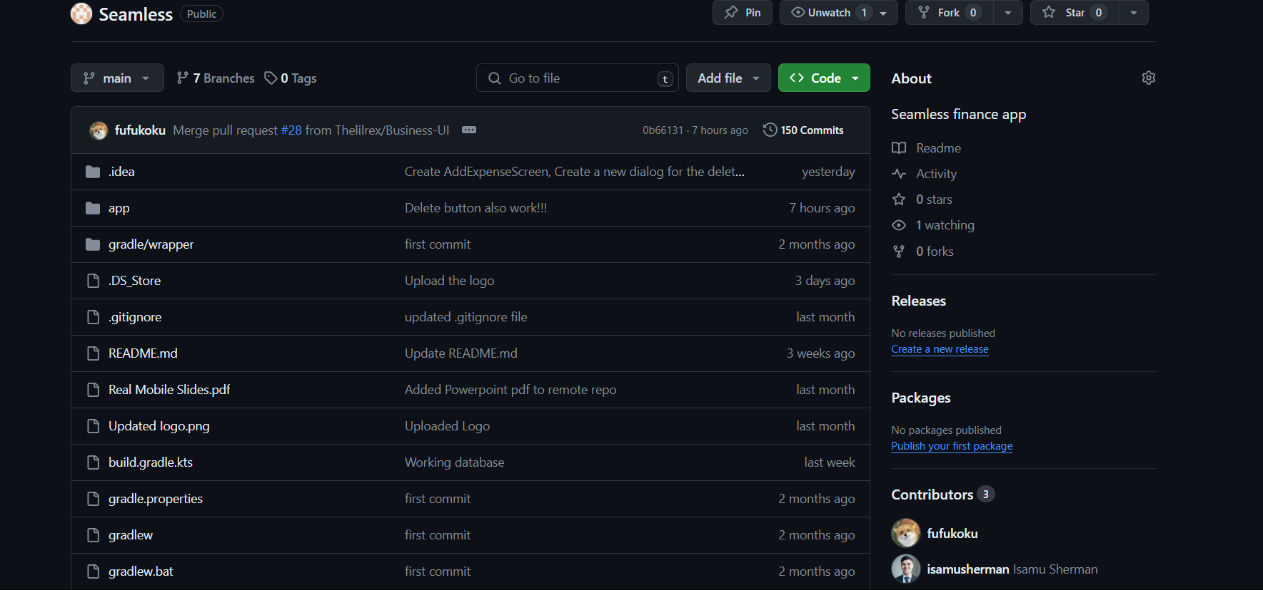
Git
We became a bit familiar with git and its commands

Slide 19
Q and A

Slide 20
Thank you

Slide 21



The Team
Anurag Reddy
Database
Isamu Sherman
Navigation
Repo Maintenence
Software Architecture
Product Design
Kaen Zhang
User Interface

